Slide 1
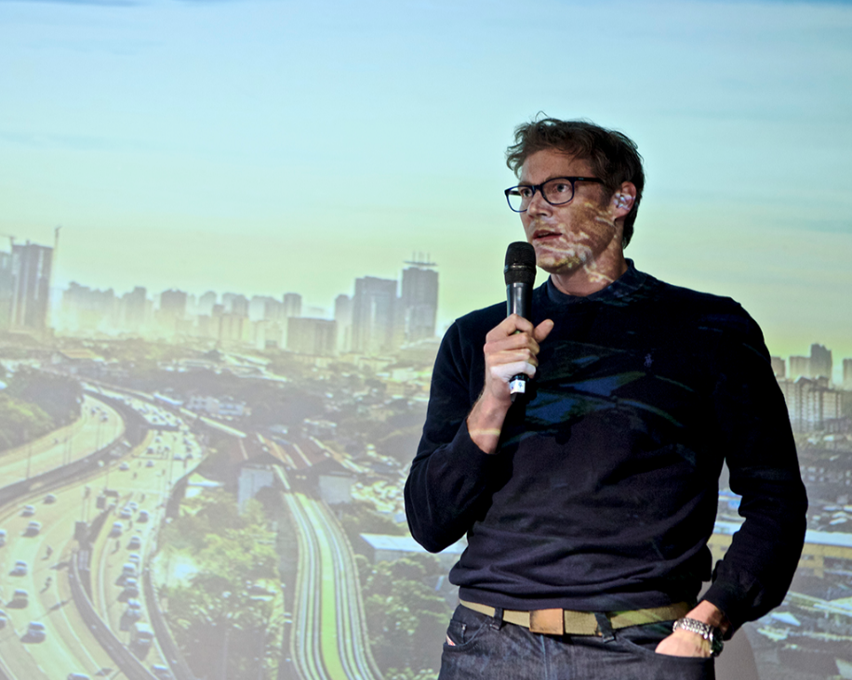
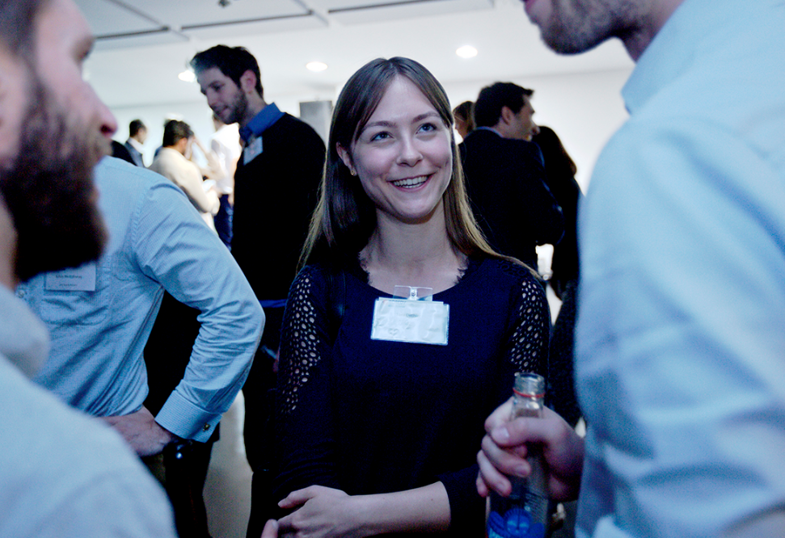
YPN FutureTech: Power to the People
Join the debate and discover how consumer technology is shaping the energy transition
Runway East Moorgate, 10 Finsbury Square, London , EC2A 1AF
Thursday 20th June, 6:30-9:30 pm
18:30-19:00 Event Registration & Networking Drinks
19:00-20:00 Interactive Panel Debate
20:00-21:30 Networking Reception, VR Installation & Hydrogen Fuel Cell Demonstration
EVENT SUMMARY
The Energy Transition is upon us but there’s more to the system change than wind turbines & solar. Advances in digitalisation and technology are redefining how people interact with their energy, not simply offering lower bills & increasing efficiencies but creating pro-sumers & peer-to-peer behind-the-meter micro-grids. Come along and hear more on what consumer technology could be in your home sooner than you think!
CONFIRMED SPEAKERS:
TICKET INFORMATION
Free tickets include food & drink, are limited and therefore allocated on a first come, first served basis.
Please book via the EI website: https://www.energyinst.org/whats-on/search
Jo Coleman: Shell Energy Transitions Manager | Pete Armstrong: Mixergy CEO
Chris Wright: Moxia Co-founder & CTO | Shaun McHugh: PowerLoop Vechicle-to-Grid project manager

Slide 2
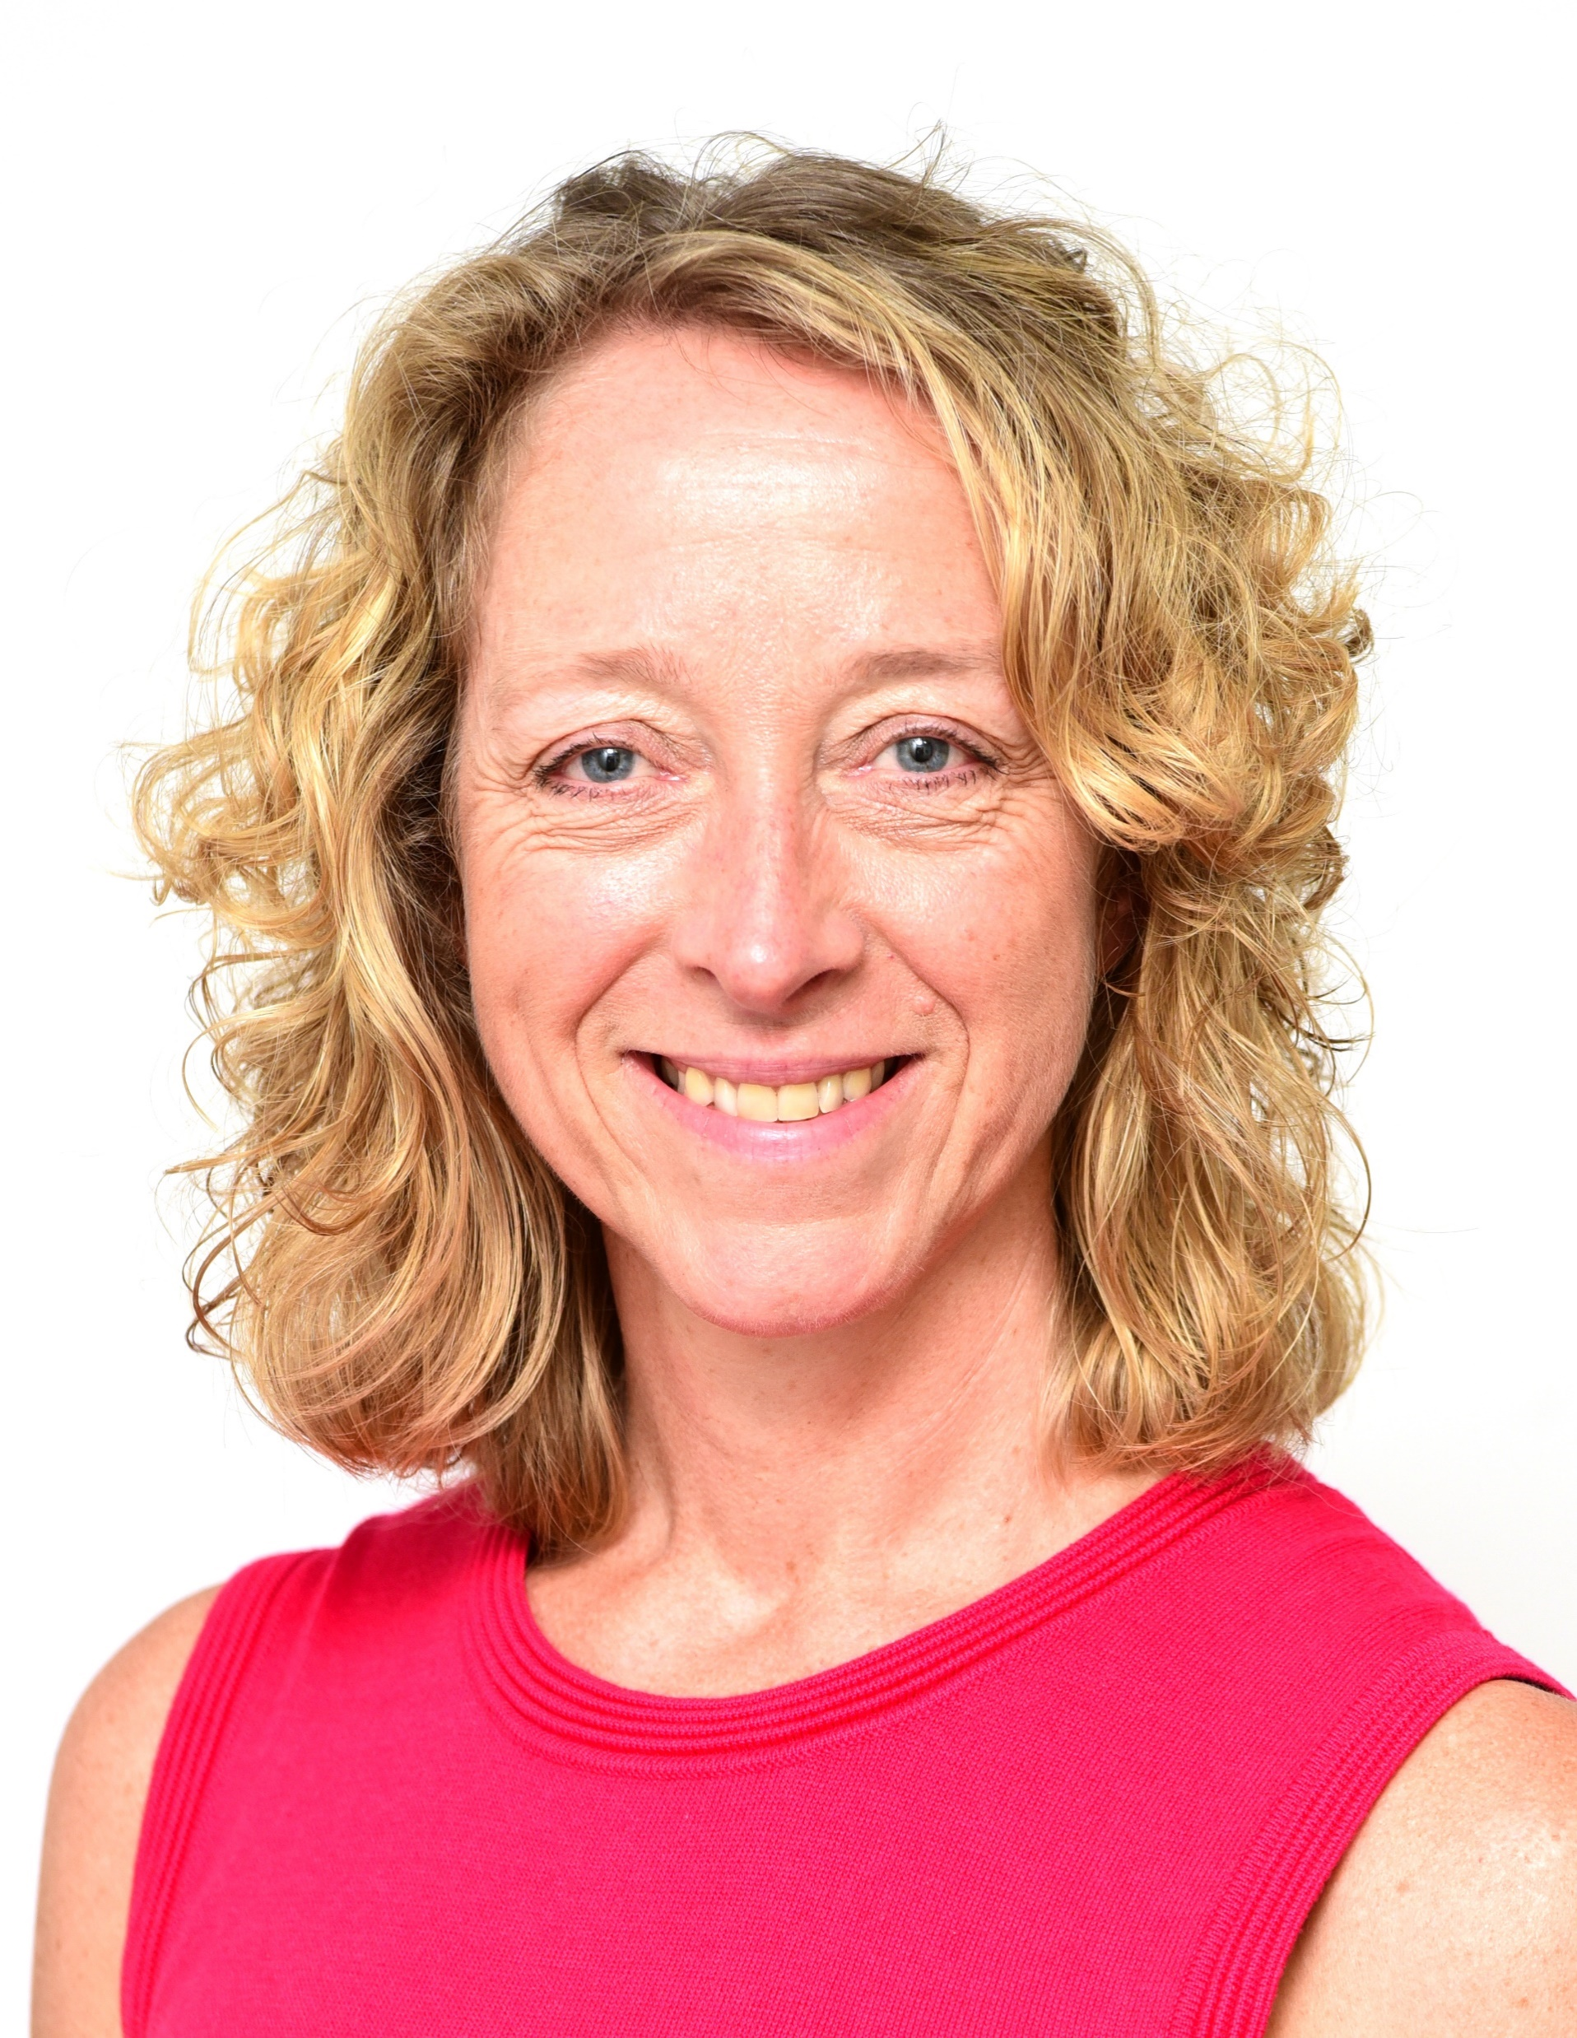
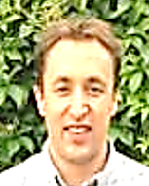
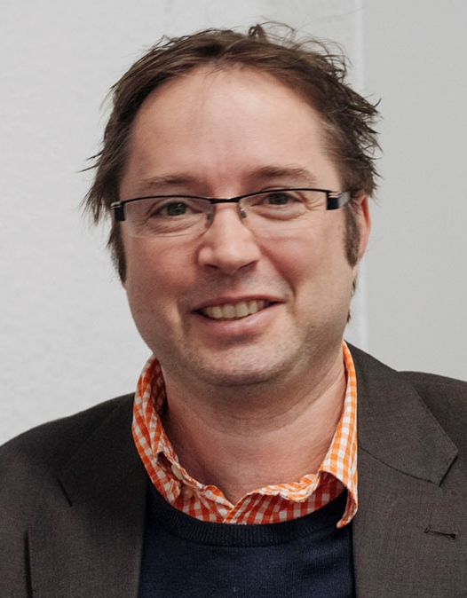
ABOUT THE PANEL SPEAKERS
Jo Coleman OBE, Energy Transitions Manager UK, Shell
Jo has worked in Shell for over 20 years in roles spanning oil and gas field development, national energy planning, economics and business development. She has worked in the Netherlands, Brunei, Oman, UAE and Malaysia. In 2011 Jo returned to the UK and joined the Energy Technologies Institute, a public-private partnership tasked with accelerating technology development and demonstration in support of the UK’s energy transition. Jo was subsequently appointed Strategy Director and led the ETI’s team of modellers and sector experts exploring UK energy transition pathways and the opportunities and challenges in delivering them. Jo returned to Shell in 2018 as UK Energy Transition Manager where she has oversight across all of Shell’s energy transition related activities in the UK. Jo was awarded an OBE in the 2018 New Year’s Honours list and is a Chartered Engineer and a Fellow of the Institute of Mechanical Engineers.
Pete Armstrong, CEO, Mixergy
Pete Armstrong worked as a design engineer on hybrid electric vehicles before starting a PhD at Oxford University on energy storage systems. Whilst at Oxford, Pete led the Oxford team which won the technical innovation award at the Shell Eco Marathon in 2013, an electric car endurance contest. The award recognised a novel, reconfigurable PV array and phase controlled clutch system. In 2014, Pete and his colleague, Ren Kang, set up Mixergy Limited, a company which is developing intelligent hot water tanks to absorb surplus renewable energy from the National Grid. Mixergy is building the largest virtual battery in the Northern Hemisphere through the deployment of smart hot water tanks and has received investment from Centrica, owner of British Gas to deploy throughout the UK.
Chris Wright, Co-founder & CTO, Moxia
Chris Wright founded Moixa with Simon Daniel in 2006 and leads technology development as CTO. Over the last 7 years Moixa have developed the UKs leading domestic energy storage system with their UK market-leading Moixa Smart Battery. They are now rolling out their Gridshare aggregation platform to multiple manufacturers as they expand.
Moixa is based in London’s Clerkenwell design district, has a roster of patents in the arena of computer interface technology, batteries and renewable energy.
Chris studied architecture at Cambridge University and worked as an architect at practices including Norman Foster and Partners, and in industrial design, before founding Moixa to address Energy systems.
Shaun McHugh, Powerloop V2G Project Manager, Octopus Energy
Shaun works at Octopus Energy as the project manager of Powerloop, an Innovate funded trial of domestic Vehicle-to-Grid charging. Five years ago he was answering phone calls from energy customers, now he's in control of a £7 million budget. This fact doesn't worry him at all. Honest. Shaun believes new technology like V2G is vital in pushing the UK grid towards a greener and more sustainable future.
And you! Pre-ask the difficult questions on our twitter feed and join the debate on the night
@EIYPNLondon

